Slide 1
Hospital Annual Reporting
State Health Planning and Development agency
Bradford L. Williams, data/planning director

Slide 2
Mandatory Facility Reporting
Act 2015-471 “Alabama Health Planning Facilitation Act”
“….to provide for certain mandatory health care reporting to SHPDA; to designate the SHPDA as the agency to collect, compile, and analyze the collected reports; to establish and provide for the membership of the Health Care Information and Data Advisory Council; to require that the SHPDA, after receiving advice and guidance from the council, adopt rules to implement this act; to provide for penalties for failure (to) make the required reports; and to require the SHPDA to meet certain deadlines or lose its authority to require the reporting.”

Slide 3
Alabama Health Planning Facilitation Act
Signed June 2015
Created Health Care Information and Data Advisory Council
Requires SHPDA allow for electronic filing of reports by providers
If electronic filing not available within 1 year of effective date of act, act becomes null and void
Reporting to SHPDA made mandatory
Created administrative penalties of up to $5,000 for rural providers/$10,000 for non-rural providers for non-compliance
Non-compliance with reporting bars participation in CON process as applicant OR opponent
Rule making process required to be completed within 1 year of effective date of Act

Slide 4
Health Care Information and Data Advisory Council
13 member board “…..charged with advising and participating in the writing of rules necessary to implement this (A)ct and reviewing reports prior to dissemination by SHPDA”
2 members appointed by Alabama Hospital Association
2 members appointed by Alabama Nursing Home Association
1 member appointed by Assisted Living Association of Alabama
2 members appointed by Alabama Hospice and Palliative Care Organization
1 member appointed by Alabama Home Care Association
1 member appointed by Chair of the Statewide Health Coordinating Council (SHCC)
2 members appointed by Ambulatory Surgery Center Association
1 member appointed by Alabama Department of Mental Health
Chair of Certificate of Need (CON) Review Board or his/her designee
Current Chairman – F. Wayne Pate - SHCC

Slide 5
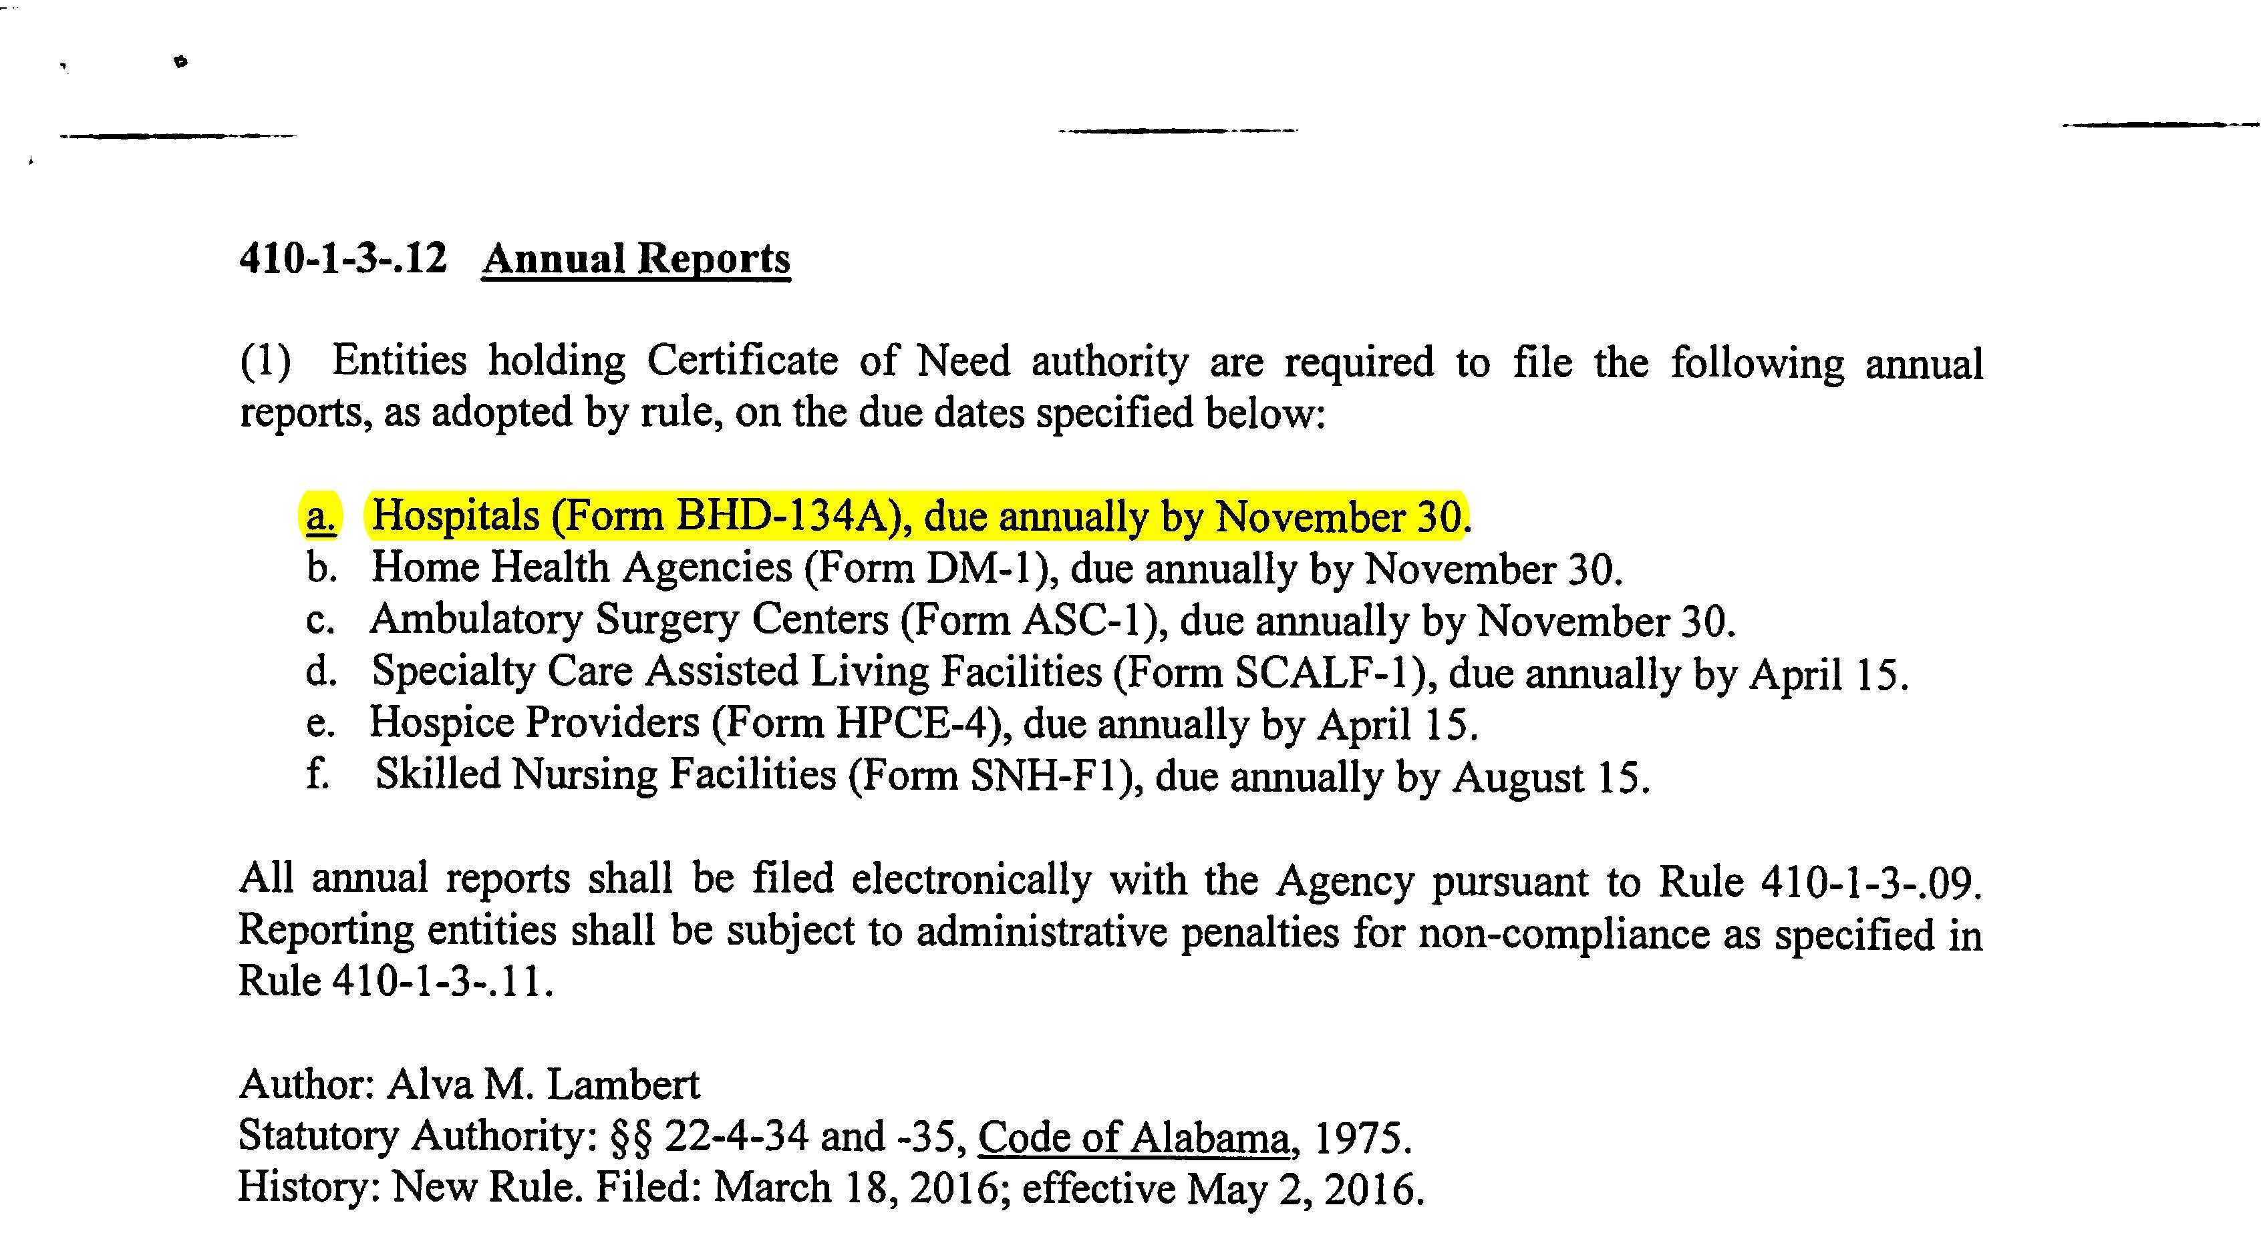
410-1-3-.12
Annual Reports
Defines the current annual report types collected by SHPDA, and the dates on which they are due

Slide 6
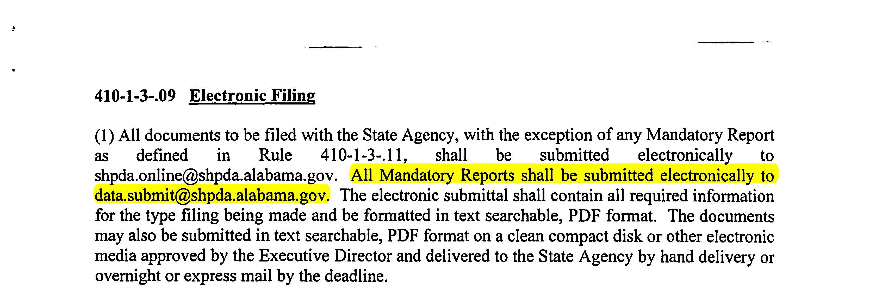
410-1-3-.09 Electronic Filing
Rule provides for electronic filing of all documents with Agency, including Mandatory Reports
Mandatory reports shall be submitted to data.submit@shpda.alabama.gov
May also be submitted on disk if e-mail submission not available from provider, but must still be received prior to deadline established by rule

Slide 7
410-1-3-.11
Submission of mandatory reports;
administrative penalties

Slide 8
410-1-3-.11 Submission of Mandatory Reports; Administrative Penalties
Section establishes policies and procedures for mandate, compliance and enforcement
Places requirements on providers AND on SHPDA staff
Written to ensure accurate and up to date information available to SHCC and CON Review Board for health planning purposes
Establishes “level playing field” – all providers treated equally, maximum penalties reduced for rural providers, and small provider status created to also allow for reduced maximum penalties
Rules were written by the Data Council, with CON Review Board, SHCC, Agency and Industry input and recommendations

Slide 9
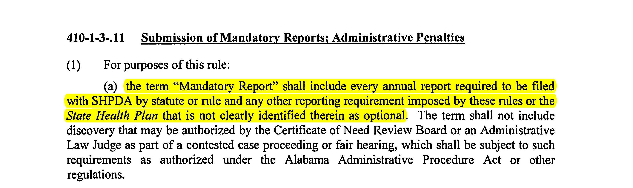
“Mandatory Report”
Defines the term Mandatory Report – types of reports are listed in 410-1-3-.12, Annual Reports

Slide 10
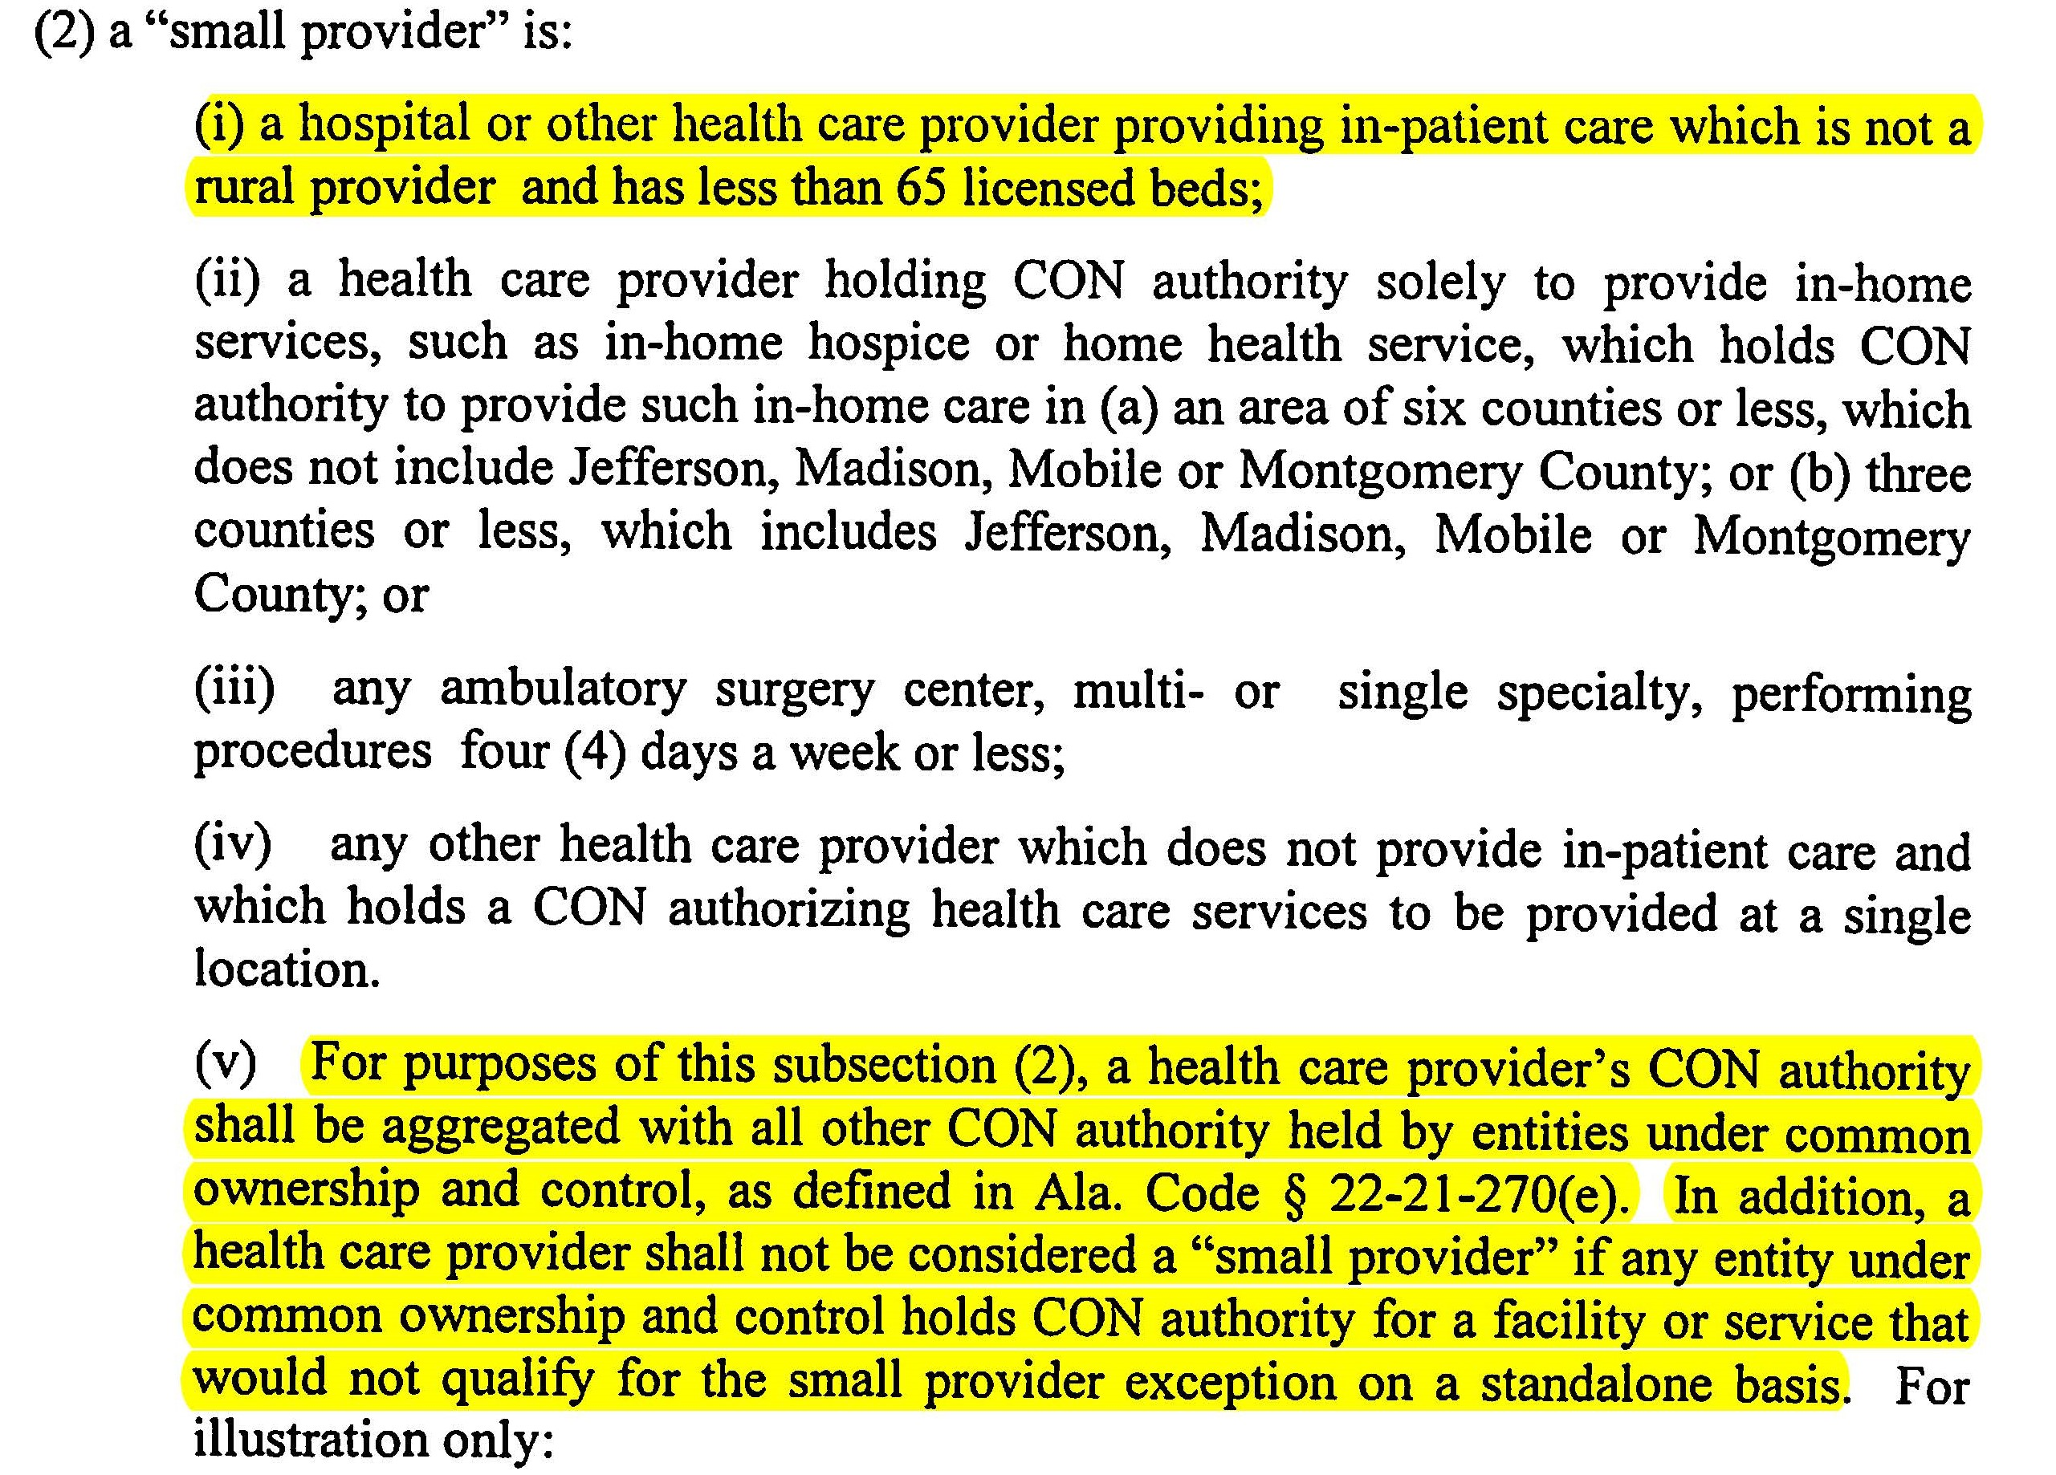
“Small Provider”
Section provides varying definitions of a “small provider” for purposes of this rule ONLY
Facilities in non-rural areas with fewer than 65 beds
All facilities under common ownership are considered together in determining “small provider” status for any facility required to file by rule

Slide 11
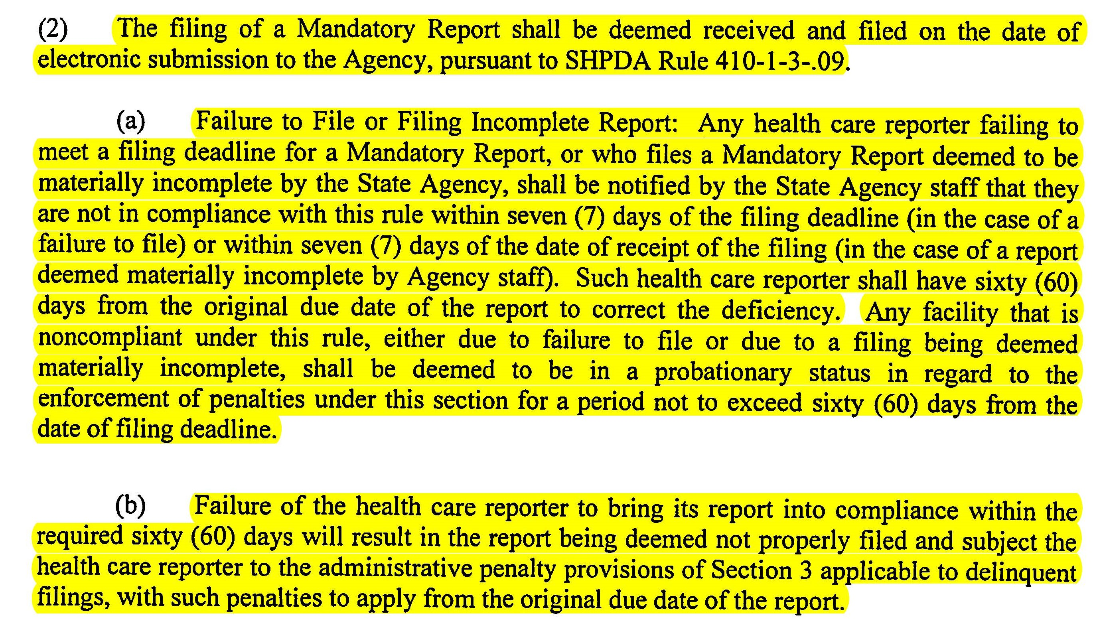
“Failure to File”
Reports are deemed received on the date they are electronically submitted
SHPDA has 7 days to determine if submission is “materially complete” and notify reporter of deficiencies
SHPDA has 7 days following deadline to contact facilities that have not submitted
60 day grace period following due date to bring reporter into compliance with rules

Slide 12

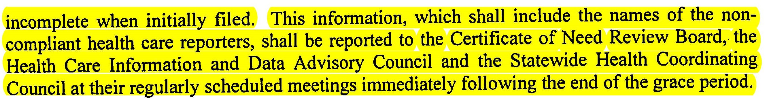
Mandatory Report Tracking/Board Reporting
SHPDA is required to track compliance status of all reporters
SHPDA is required to report compliance of all reporters to all 3 governing boards (CON, SHCC, HCIDAC) at meeting immediately following end of grace period
Identification of both late and materially incomplete reporters are to be provided to boards

Slide 13
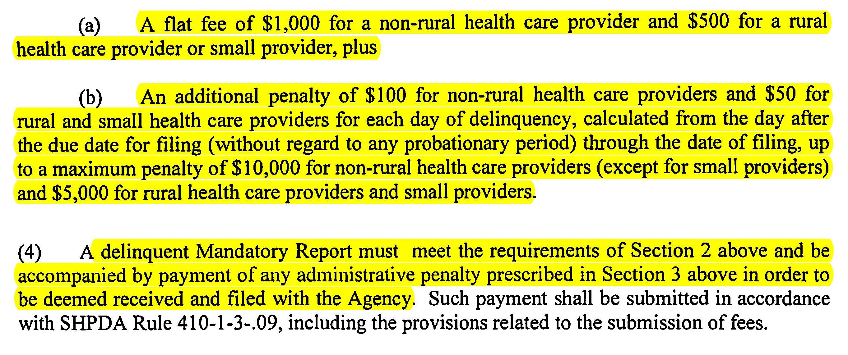
Financial Penalties for Non-Compliance
Any facility not compliant with rules following grace period will face a financial penalty
Penalty dependent on if reporter is deemed rural or “small provider” as previously defined
Per day penalties begin the day after due date, not after grace period
Waivers of penalty only under extreme circumstances defined by rule
Late/incomplete reports deemed complete during grace period do not face financial penalties

Slide 14
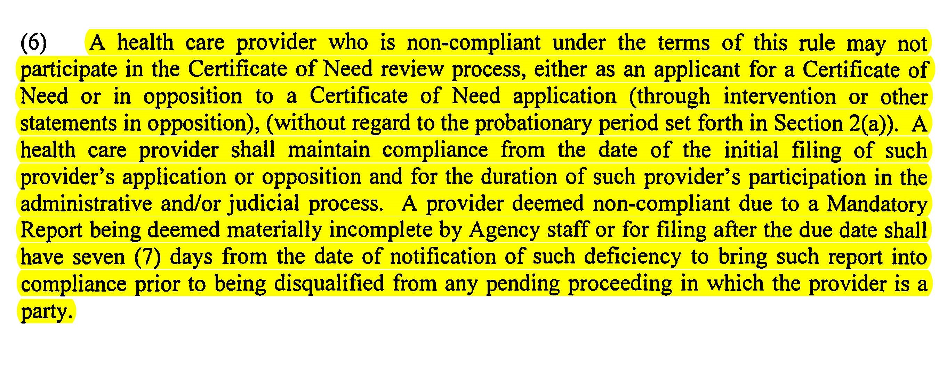
Non-participation in CON Process
Failure to submit materially complete mandatory report prior to due date blocks participation in CON process as applicant OR opponent
Penalty is in effect during grace period
Active filings and/or opposition can also be affected if compliance is not achieved within 7 days
Reporter must maintain compliance through entire application process

Slide 15
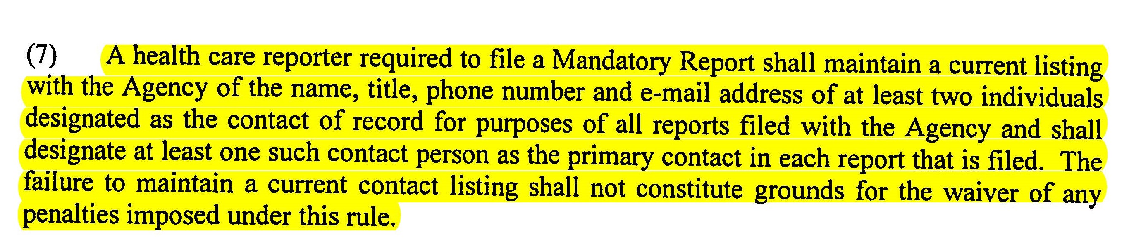
Contact of Record
Reporter required to keep current and accurate contact information on file with SHPDA
SHPDA disseminated forms to providers prior to end of current reporting period
2 contacts required for “annual report” plus 1 for Patient Origin data
Contacts responsible for receiving report and assigning to preparer

Slide 16
Form BHD 134A
2016 Annual report for
Hospitals and Related facilities

Slide 17
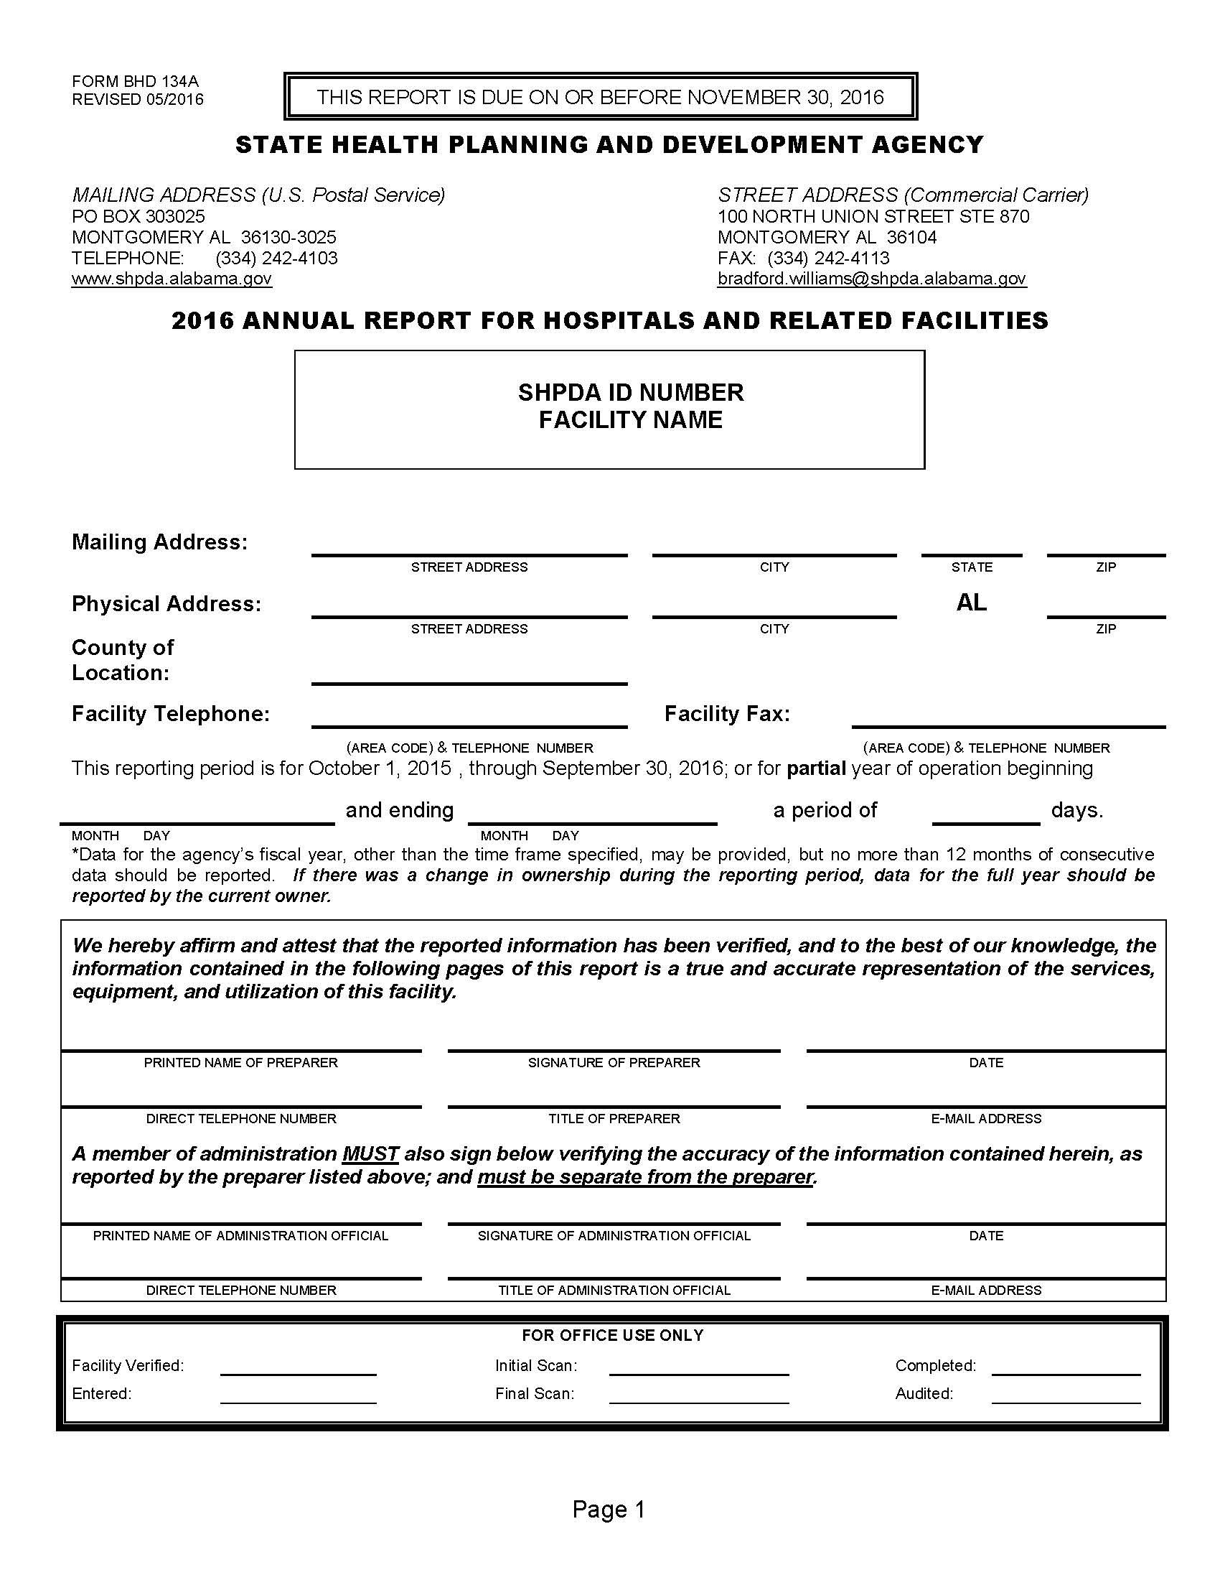
Page 1
No changes were made to this page of the annual report
2 separate individuals must sign – preparer AND member of administration who verifies accuracy of reported information
Report must have both SHPDA Facility ID number AND Facility Name AS REPORTED TO SHPDA listed on report in appropriate location shown

Slide 18
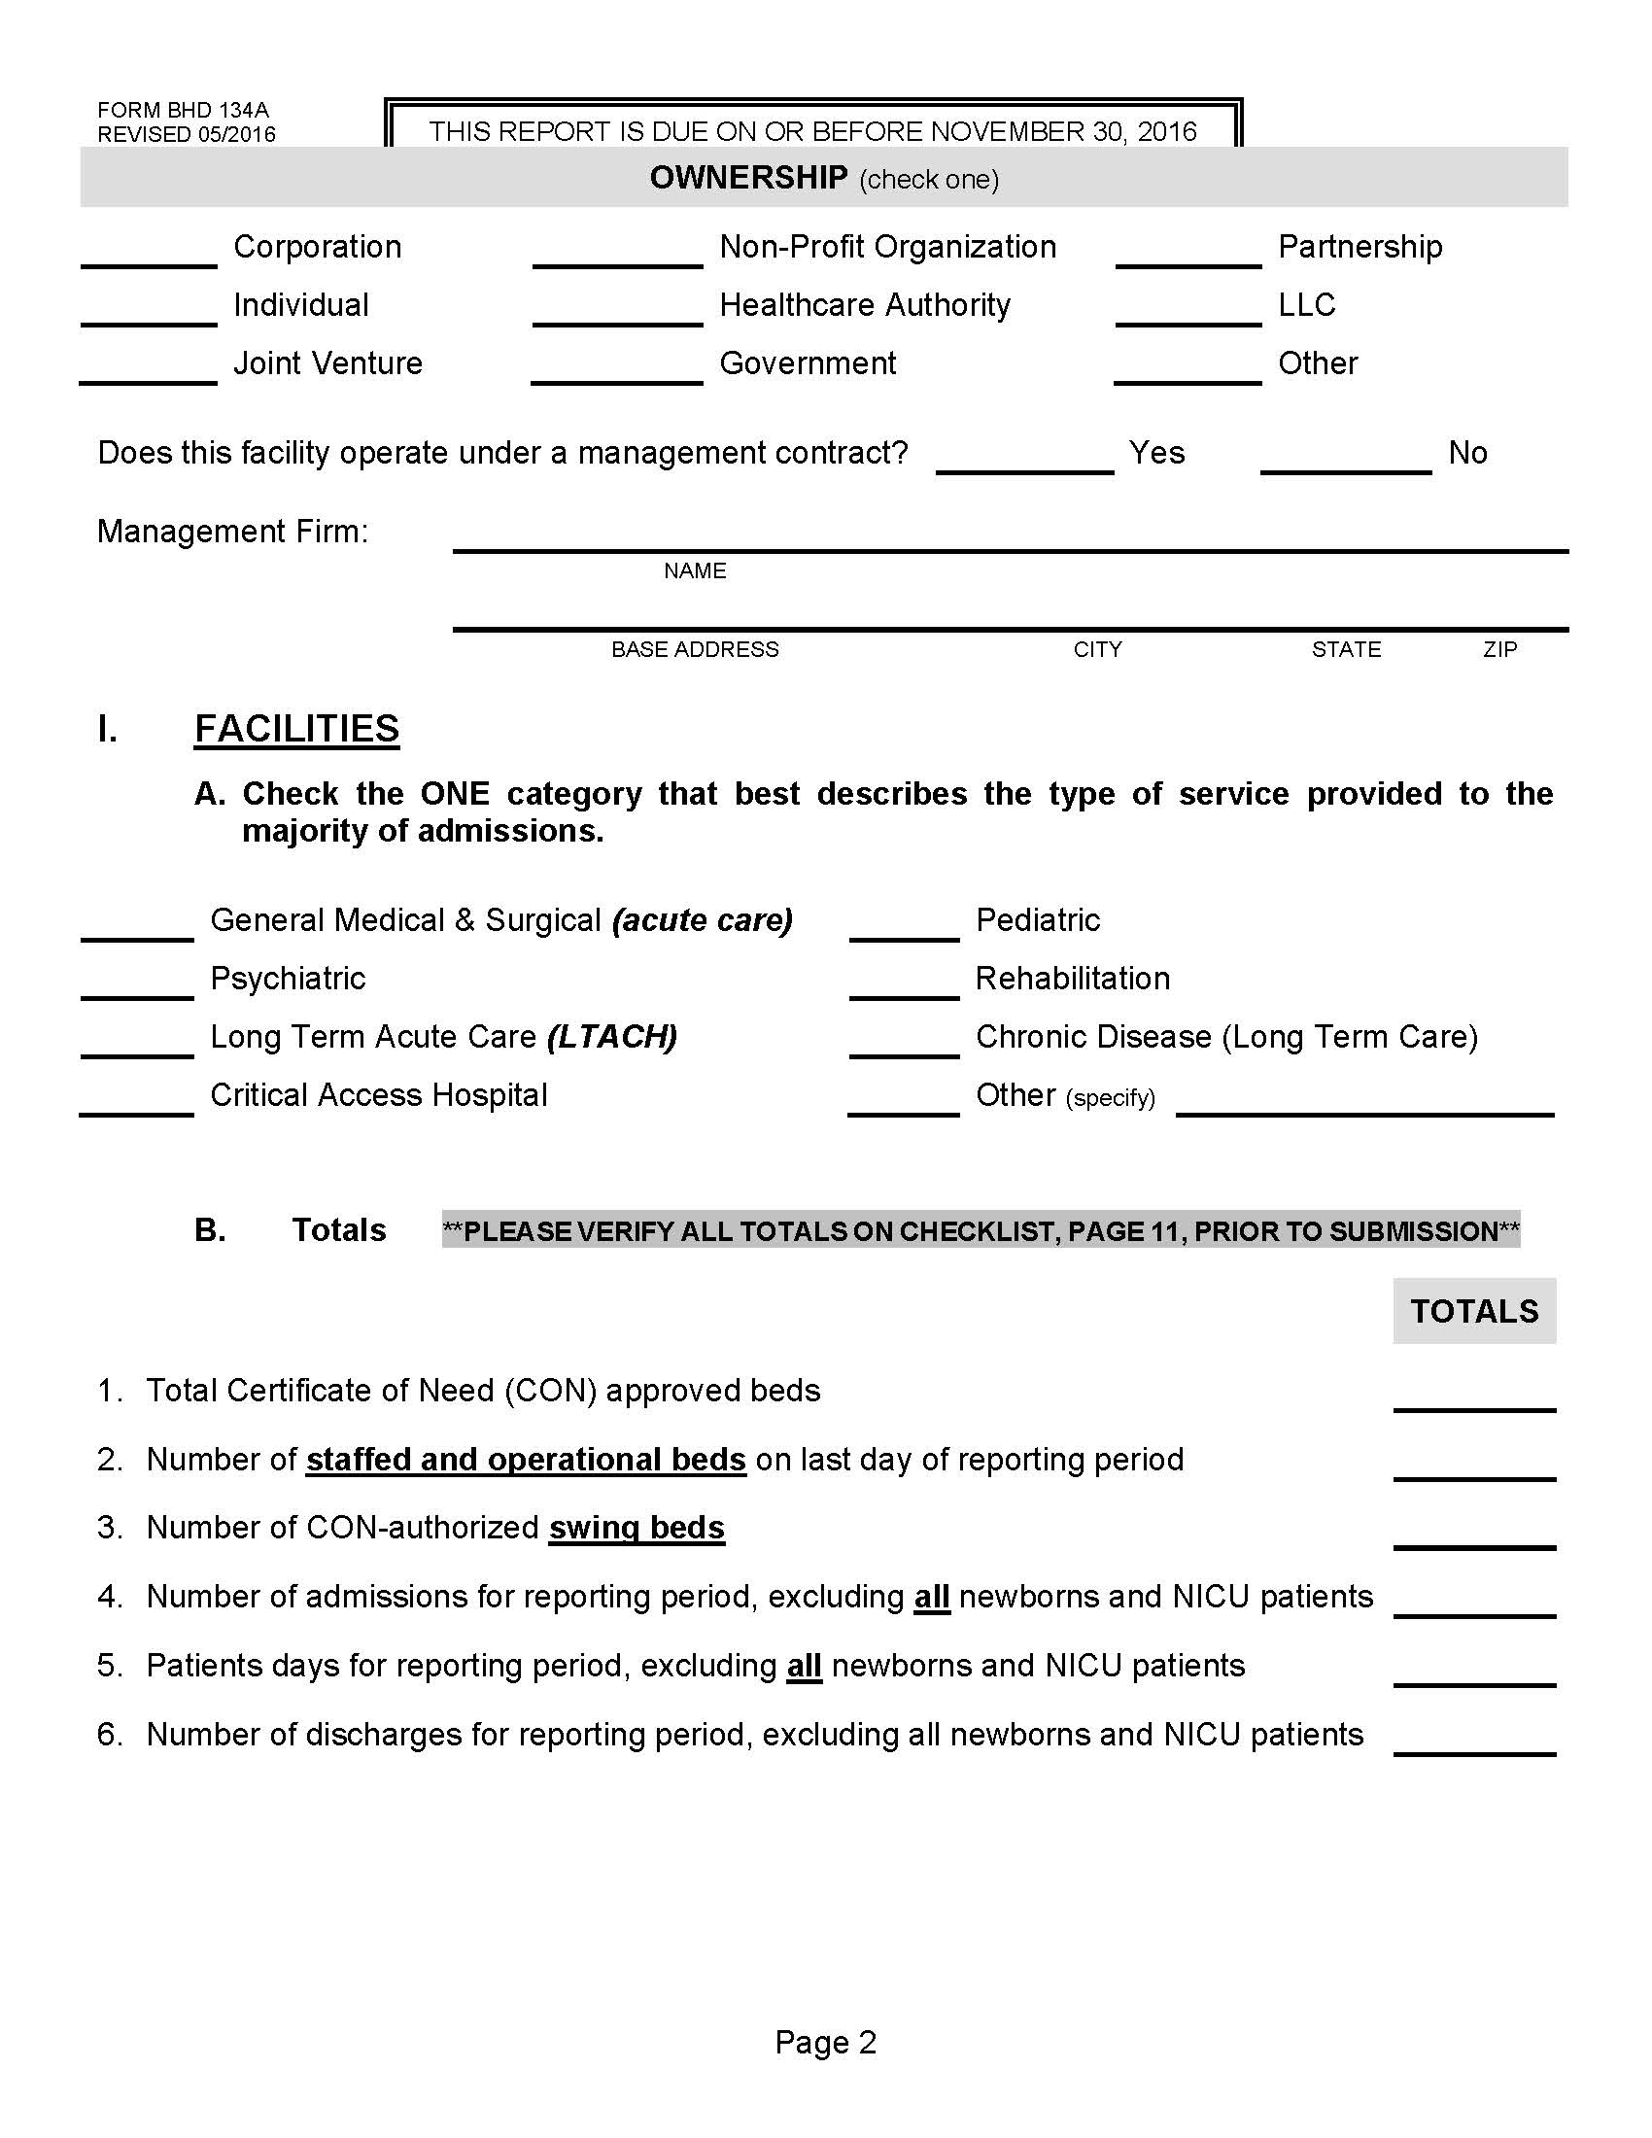
Page 2
Outpatient Visits removed from Section I-B
Total numbers reported in Section I-B should equal totals throughout report
Applies to CON approved beds, Staffed Beds, Discharges, and Patient Days

Slide 19
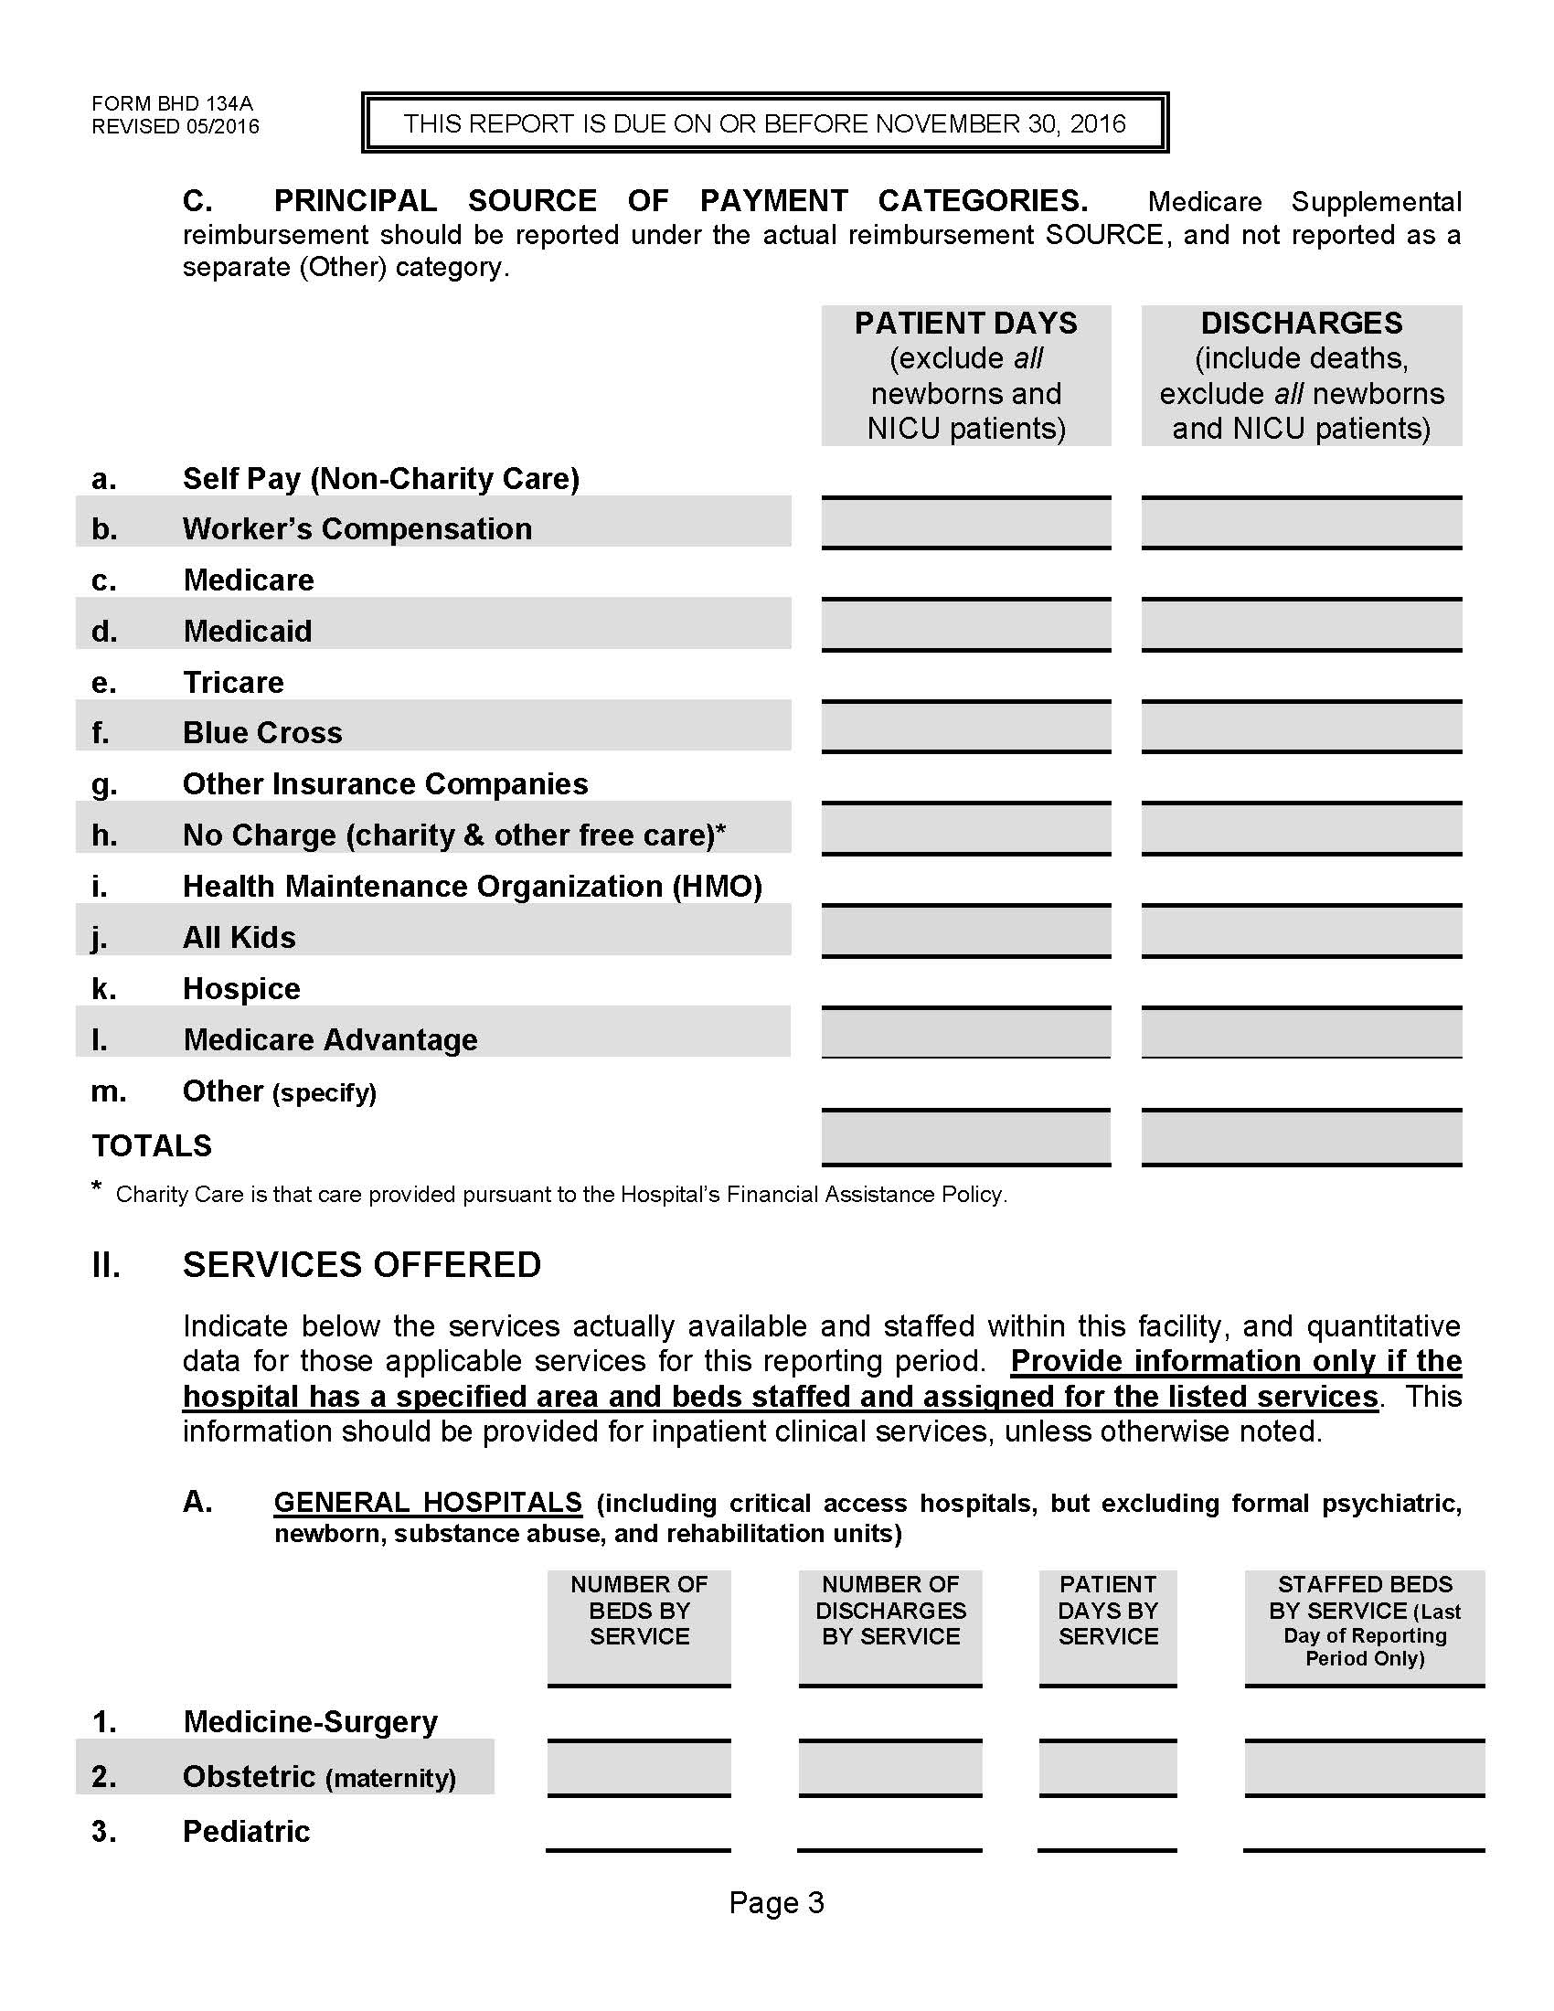
Page 3
Medicare Advantage added as an additional source of payment in Section I-C.
Total discharges and total patient days reported in Section I-C should equal totals reported on Page 2, Section I-B.
Section II-A (General Hospitals) is for general acute care hospitals ONLY. Specialty hospitals will fill out Section II-B on page 4 instead.

Slide 20
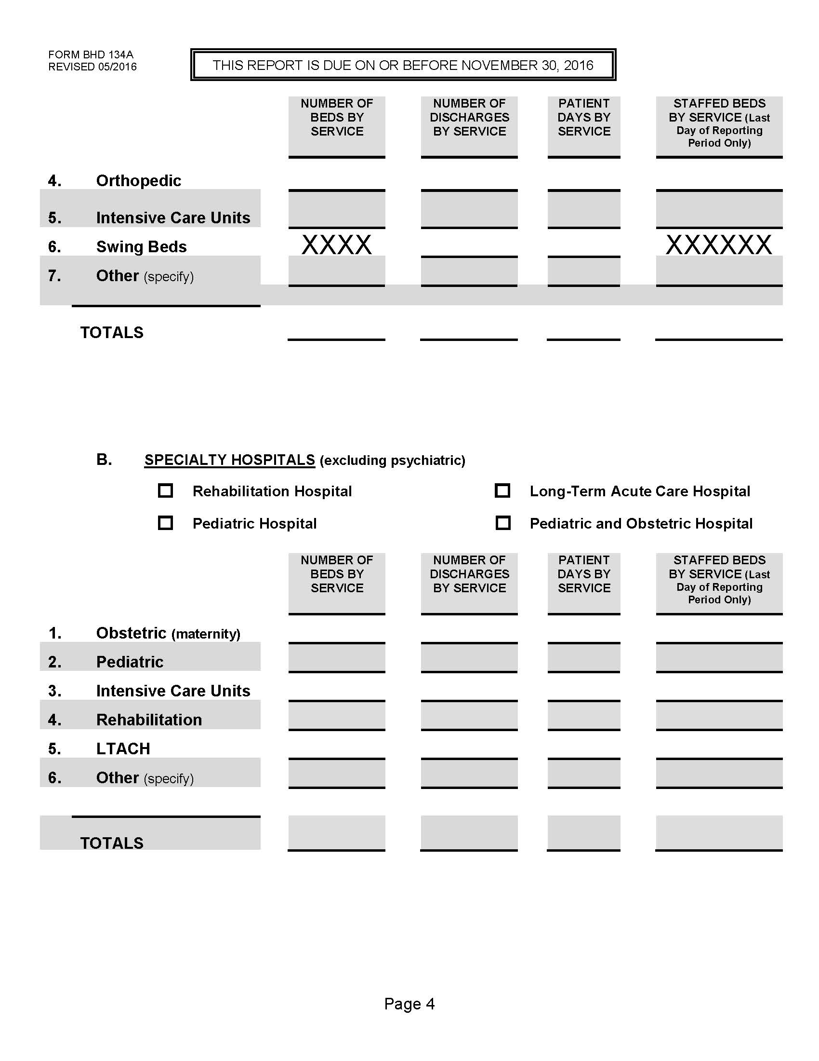
Page 4
Section II-A continues here. Totals should equal breakdowns by unit type.
Section II-B is for Specialty Hospitals from the following categories ONLY – Rehabilitation, LTACH, Pediatric, or Children’s/Women’s
Freestanding Rehab Hospitals should use this section. Acute hospitals with rehab beds should fill out rehab info on page 5, not in this section.

Slide 21
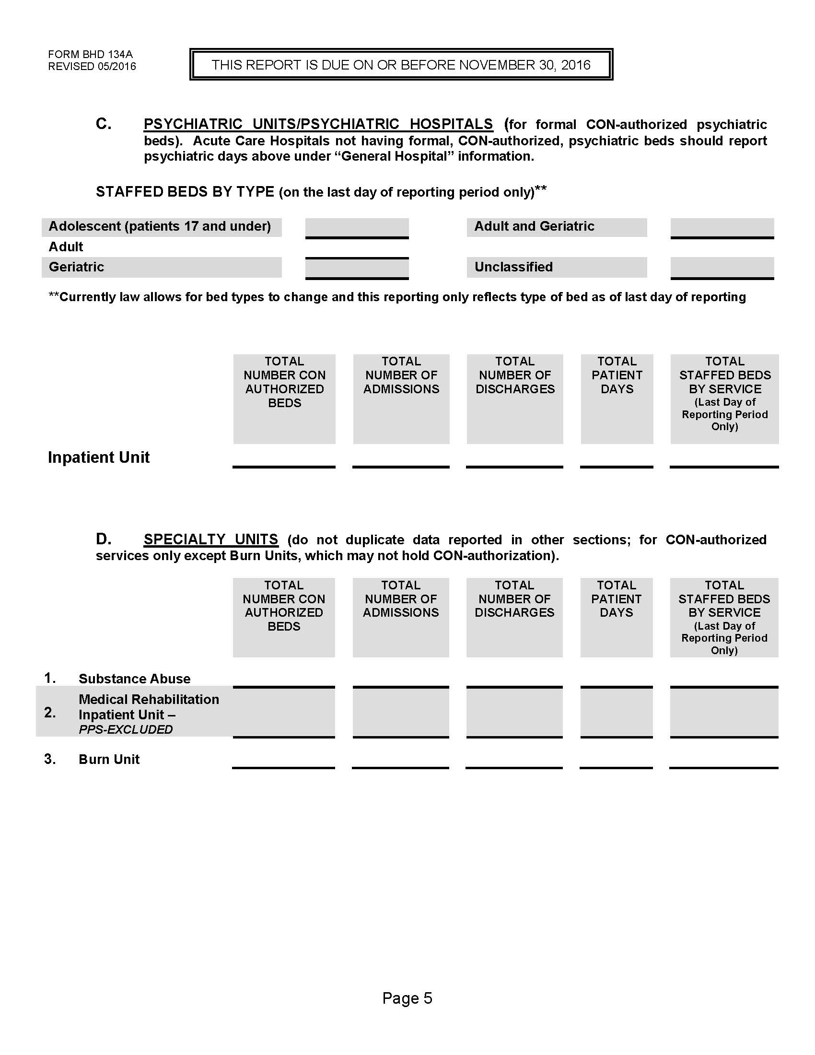
Page 5
Freestanding Psych hospitals OR psych units in acute care hospitals should report in this section. Report the number of each type of psych beds by age group on the last day of reporting period.
Section D – acute hospitals with rehab beds should report rehab information HERE, not on Page 4.

Slide 22
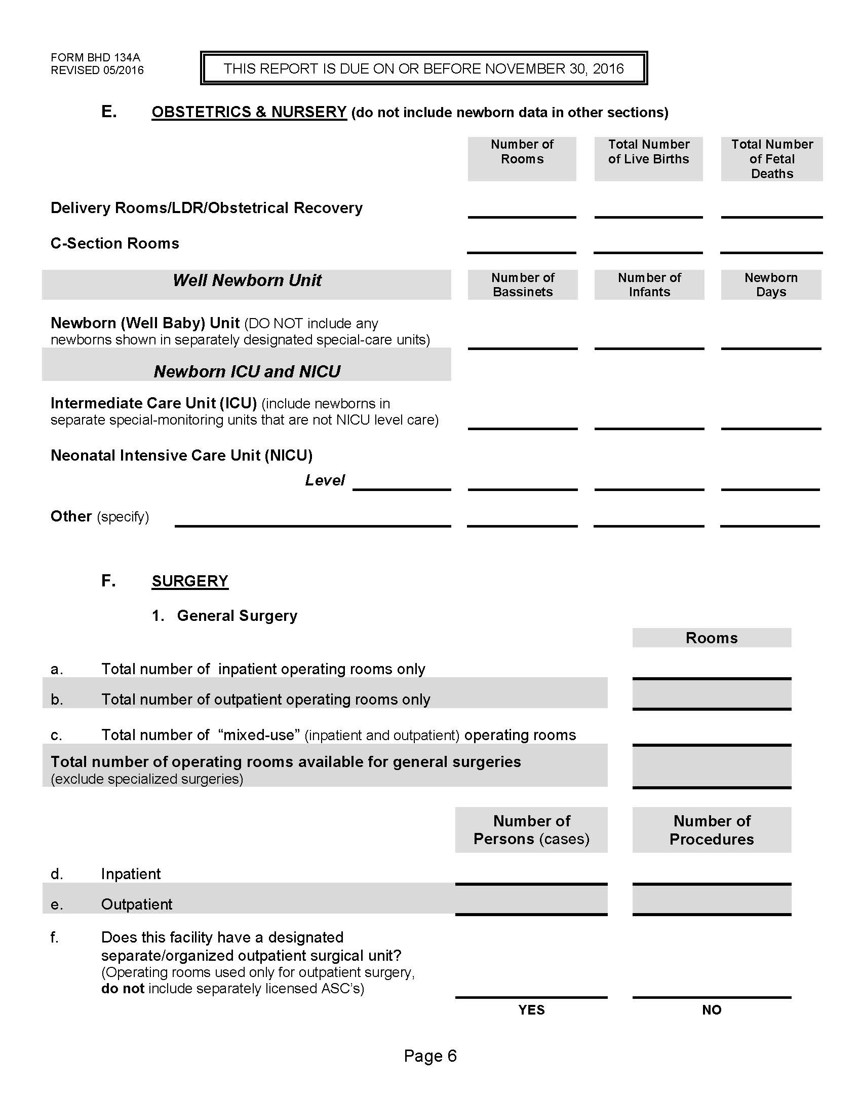
Page 6
Total number of “other” procedures and cases performed in L&D and C-section rooms removed.
Section II-F – total number of procedures performed must be equal to or greater than the number of persons (cases) reported. It cannot be less. It also cannot be 0 or blank.

Slide 23
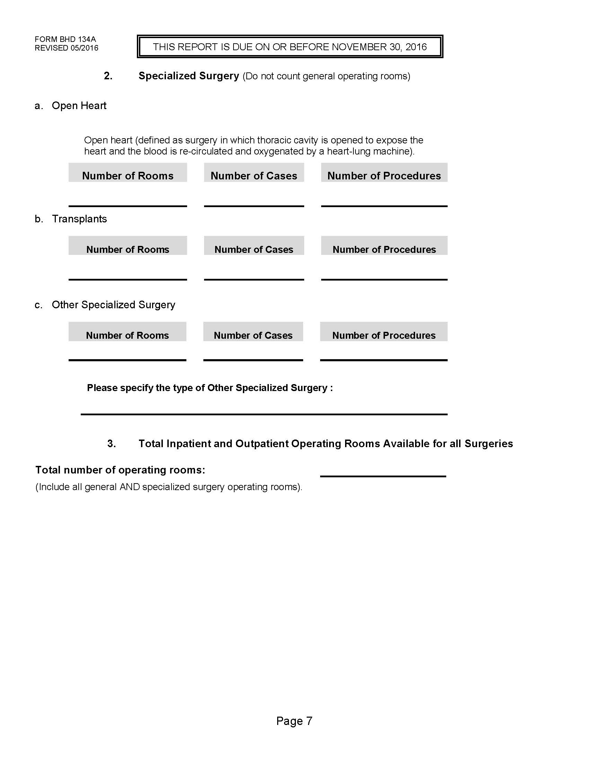
Page 7
No changes have been made to this section.

Slide 24
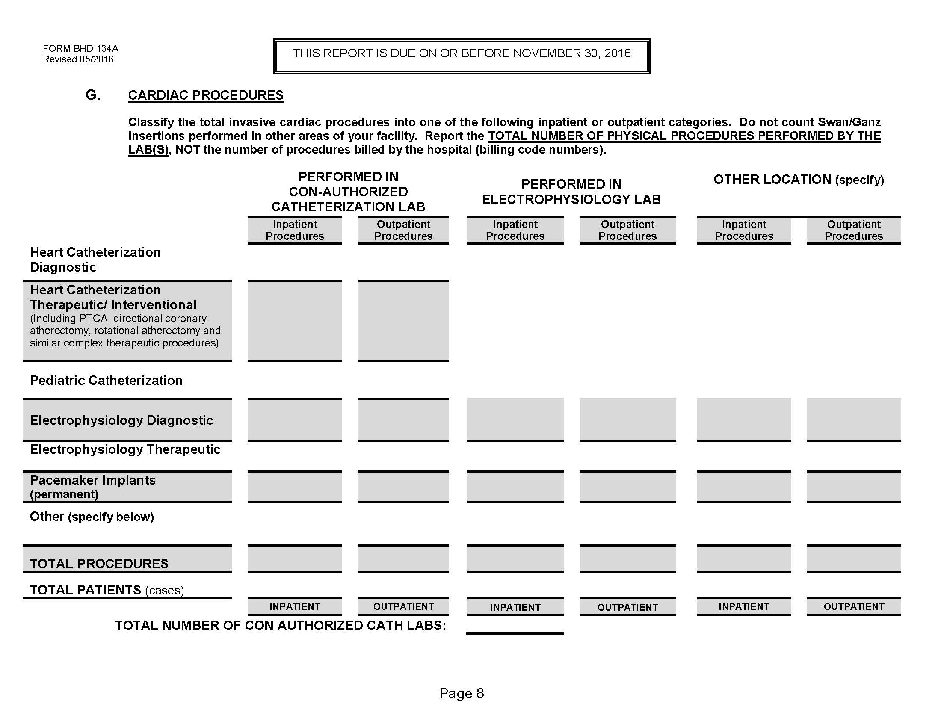
Page 8
Changes were made to this page to more accurately reflect conditions requested by the Alabama State Health Plan regarding need for new Catheterization labs.
Numbers should reflect total number of procedures performed, not procedures billed.

Slide 25
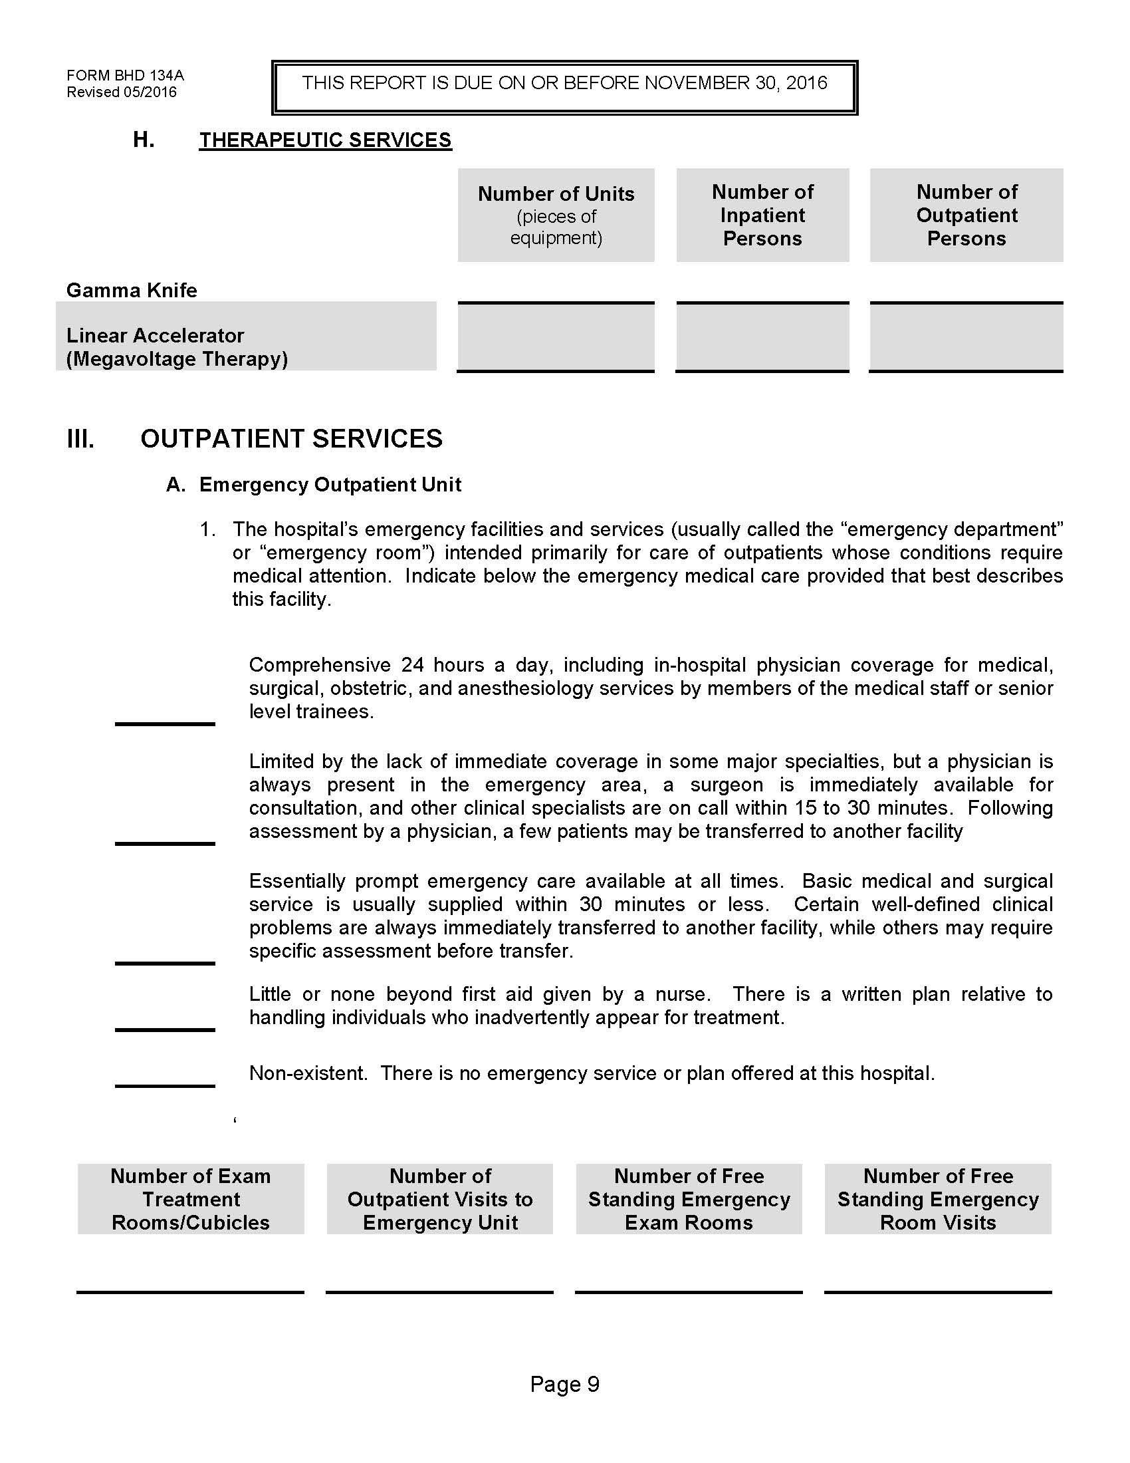
Page 9
Number of therapeutic services reduced.
Linear accelerator and megavoltage units combined.
Additional information requested for facilities operating Freestanding Emergency Departments (FEDs).
FED information is to be reported separately, not combined with onsite ER data.

Slide 26
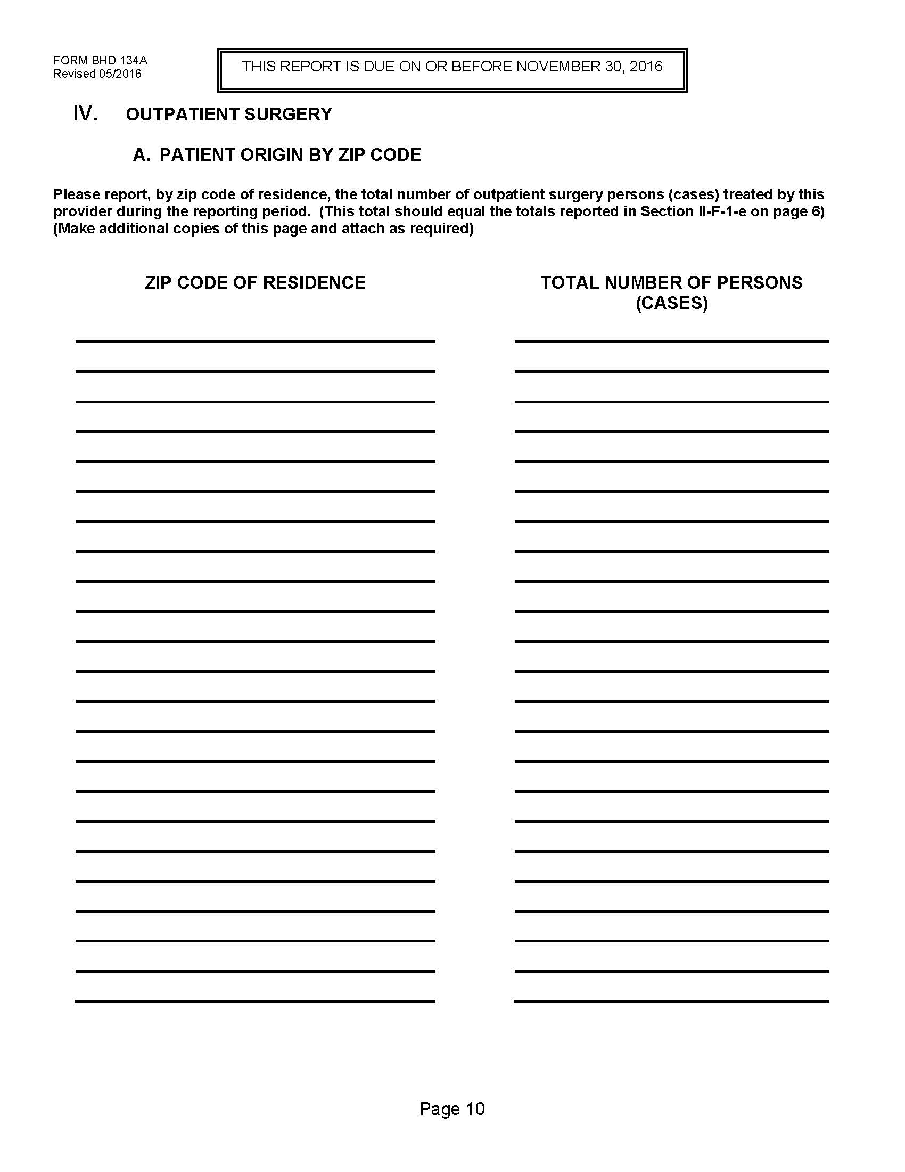
Page 10
New section requested by Association representatives on HCIDAC.
Section relates to outpatient surgery patients ONLY
For each zip code of patient residence, report total number of patients who live in that zip code that received outpatient surgery at the facility during the reporting period

Slide 27
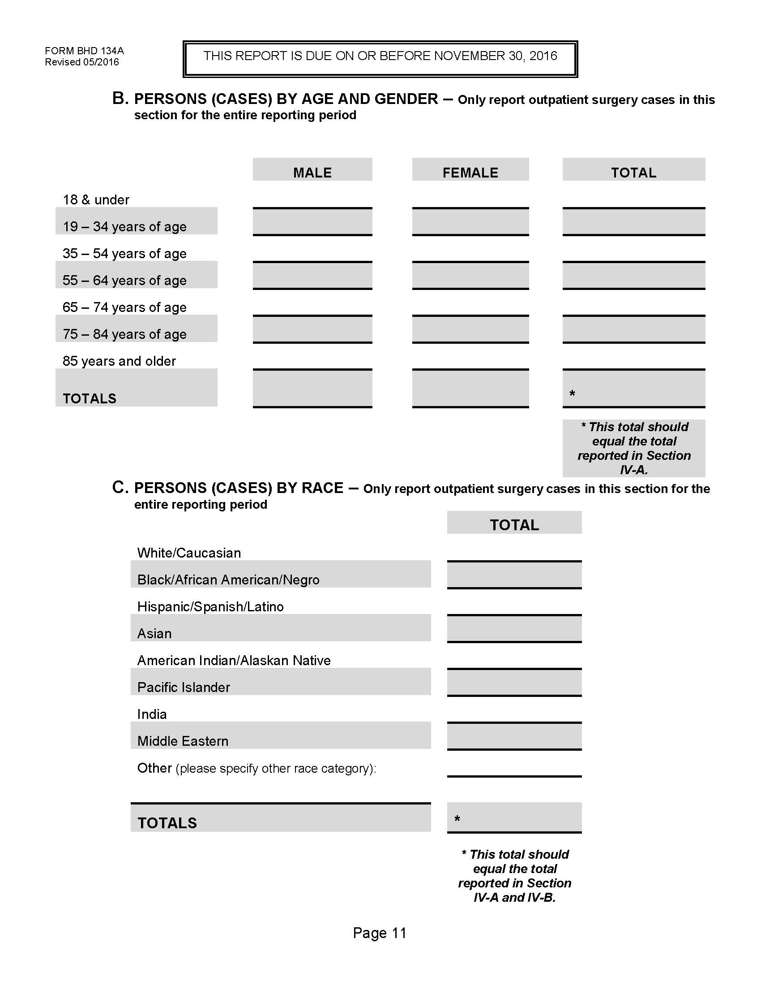
Page 11
New section requested by Association representatives on HCIDAC.
Section relates to outpatient surgery patients ONLY
Report by Age and Gender total number of patients receiving outpatient surgery during reporting period
Also report broken down by race
Totals for Sections IV-A, IV-B, and IV-C should equal

Slide 28
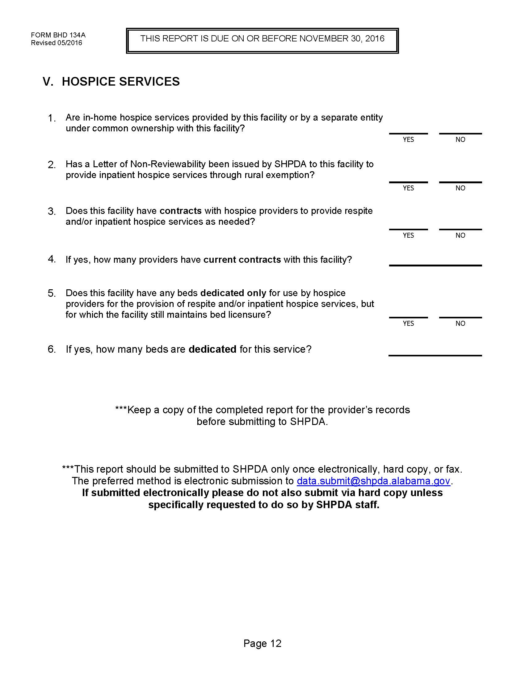
Page 12
No changes made to this page
Information used to assist in health planning for purposes of Hospice providers, both in-home and inpatient.

Slide 29
Other changes
All financial information has been removed from the annual report.
Patient origin data has been added to the annual report.
Annual report will not be deemed ‘received’ until both the utilization report (pages 1-12), AND the patient origin data (pages 13-18) have been received by SHPDA.
Annual report will not be deemed ‘materially complete’ until necessary corrections to both sections of the report have been received and deemed complete by SHPDA.

Slide 30
Patient Origin Changes
Medicare Advantage has been added as a new payer source (code 12)
“Other” payer source is now code 13
ICD-10 data point added – report patient’s primary ICD-10 diagnosis code – up to a 7 digit code WITHOUT ANY DECIMAL POINT
Data is to be submitted in Microsoft Excel (v. 2003 or later) or CSV formats ONLY.
Page 18 of the report is a cover sheet that should also be included with the patient origin data submission.

Slide 31
Additional Information
Mandate should allow for more rapid transition from collection to publication
Annual report and Patient Origin data should be available sooner and with more accuracy than ever before
Complete and accurate reporting necessary to show current utilization of extant resources AND to predict need for additional resources in future
“SHPDA may bring civil actions in any court of competent jurisdiction to enforce compliance with this act or any requirement or appropriate request of SHPDA made pursuant to this (A)ct” [Act 2015-471]

Slide 32
Contact Information/Questions
Bradford L. Williams
Data/Planning Director
Alabama State Health Planning and Development Agency
bradford.williams@shpda.alabama.gov
(334) 242-4103

